Slide 1
JavaScript Design Regrets
茶少 from 阿里巴巴
新浪微博 @哦胖茶

Slide 2
Java Legacy
The diktat from upper engineering management was that the language must “look like Java”.
-- Brendan Eich

Slide 3
Date Class
JavaScript’s Math and Date objects are based on classes from Java 1.0
const d = new Date('2016-09-10') d.getDate() // 10 d.getYear() // 116 (2016 - 1900) d.getMonth() // 8
But since JDK 1.1, most methods in Date class have been deprecated…

Slide 4
Auto-Semicolon-Insertion (ASI)
A lot of programming languages allows omitting semicolons:
Swift, Python, Mathematica, Ruby, Groovy…
Only JavaScript has problems with it

Slide 5
Auto-Semicolon-Insertion (ASI)
Imperfect Grammar -> Restricted Production
// returns undefined return { status: true }; // returns { status: true } return { status: true };

Slide 6
Auto-Semicolon-Insertion (ASI)
var a = function(x) { console.log(x) } (function() { // do something })()

Slide 7
Solution: semicolon-less style
Prefix a line with ; whenever it starts with ( [ + - /
var a = function(x) { console.log(x) } ;(function() { // do something })()

Slide 8
Outdated Features
Hey, it was the 90s!
-- Brendan Eich

Slide 9
Stateful RegExp Functions
const re = /foo/g console.log(re.test('foo bar')) // true console.log(re.test('foo bar')) // false
Based on Perl 4
No thread safety

Slide 10
Type System

Slide 11
Implicit Coercion
("foo" + + "bar") === "fooNaN" // true '3' + 1 // '31' '3' - 1 // 2 '222' - - '111' // 333

Slide 12
Equality Test

Slide 13
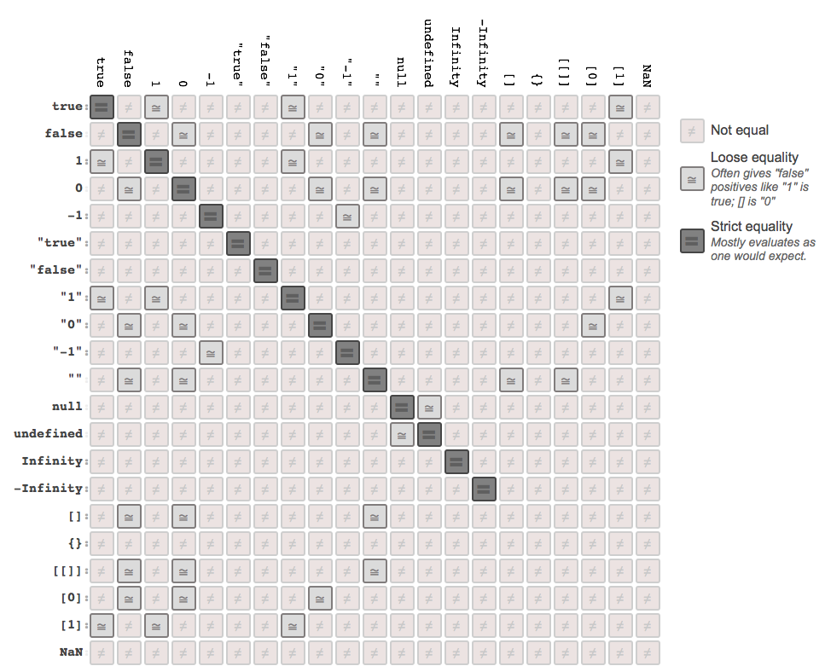

Slide 14
Equality Test
[] == ![] // true 3 == '3' // true
+0 === -0 // true 1 / +0 === 1 / -0 // false NaN === NaN // false

Slide 15
ES2015 Solution: Object.is
Object.is(NaN, NaN) // true Object.is(+0, -0) // false

Slide 16
Scope

Slide 17
Functional Scope
// The closure in loop problem for (var i = 0; i !== 10; ++i) {
// logs 10 ten times setTimeout(function() { console.log(i) }, 0) }

Slide 18
Solution: Block Scope (let / const)
for (let i = 0; i !== 10; ++i) {
// logs 0, 1, 2, 3, 4, 5, 6, 7, 8, 9 setTimeout(function() { console.log(i) }, 0) }

Slide 19
Variable Hoisting
bla = 2 var bla; // ...
// is implicitly understood as: var bla; bla = 2;

Slide 20
Solution: Temporay Dead Zone
// without TDZ console.log(a) // undefined var a = 1
// with TDZ console.log(b) // ReferenceError let b = 2

Slide 21
Naming Regrets
There are only two hard things in Computer Science: cache invalidation and naming things.
-- Phil Karlton

Slide 22
let / const
What const defines is not actual constant
// const defines an immutable binding const MY_OBJECT = {"key": "value"}; // Overwriting the object will cause TypeError MY_OBJECT = {"OTHER_KEY": "value"}; // However, object keys are not protected, // so the following statement is executed without problem MY_OBJECT.key = "otherValue"; // Use Object.freeze() to make object immutable

Slide 23
let / const
If we had a “do-over”. I‘d make let means what const now means and have something different for defining mutable lexical bindings. Maybe let var foo=...;.
-- Allen Wirfs-Brock (Project Editor and lead author of ES2015)

Slide 24
Function.prototype
[[Prototype]] !== prototype
fallbackOfObjectsCreatedWithNew would be a better name

Slide 25
Correct Ways to Access [[Prototype]]
Object.getPrototypeOf() (ES5)
.__proto__ (non-standard until ES2015, not supported in IE)

Slide 26
API Design Failure

Slide 27
import syntax
JavaScript: import { x, y } from z
Python: from z import x, y
Actually, JavaScript’s module system was inspired by Racket, not Python.
The syntax would be much better if it’s just copied from Python!

Slide 28
NaN
isNaN isNaN(123) // false isNaN(NaN) // true isNaN(’a string’); // true
Number.isNaN

Slide 29
Array Constructor Inconsistency
Array(1, 2, 3); // [1, 2, 3]
Array(2, 3); // [2, 3]
Array(3); // [,,] 黑人问号???

Slide 30
Array-like Objects
typeof arguments.length // number Object.prototype.toString.call(arguments) // [object Arguments] arguments.slice(0, 1) // TypeError: arguments.slice is not a function
var args = Array.prototype.slice.apply(arguments) Object.prototype.toString.call(arguments) // [object Array] args.slice(0, 1) // no error

Slide 31
Array-like Objects in ES2015
const nodeList = document.querySelectorAll('div') const nodeArray = [...nodeList] console.log(Object.prototype.toString.call(nodeList)) // [object NodeList] console.log(Object.prototype.toString.call(nodeArray)) // [object Array]

Slide 32
Value Properties of the Global Object
NaN, Infinity, undefined are not reserved keywords
;(function(){ var undefined = ‘foo’ console.log(undefined, typeof undefined) // logs "foo string" })()

Slide 33
eval
function test() { var x = 2, y = 4 // Direct call, uses local scope, result is 6 console.log(eval(“x + y”)) var geval = eval; // Indirect call, uses global scope, throws ReferenceError because `x` is undefined console.log(geval("x + y")) }

Slide 34
Why the difference?
eval has access to local scope, which is dangerous
In ES1, nobody cares
In ES2, only direct call is allowed
But it breaks the web
So, browser vendors have to implement it to behave like new Function()

Slide 35
Q & A

Slide 36
Thanks!

